Slide 1
ETSI 004

Slide 2
Symmetric Keys Python Application
TCP Socket
Alice (Application) (Python)
Encrypted messages
Bob (Application) (Python)
encrypt(), decrypt(), get_key(), get_key_bytes()
encrypt(), decrypt(), get_key(), get_key_bytes()
Application Class (Python)
Application Class (Python)
open_connect(), get_key(), close()
open_connect(), get_key(), close()
Application Driver (Python)
Application Driver (Python)
TCP Socket
TCP Socket
ETSI 004
LKMS node 1
LKMS node 2
Bitstream
Bitstream
Random number generator
Same seed !
Random number generator

Slide 3
Symmetric and Raw Keys Python Application
TCP Socket
Alice (Application) (Python)
Encrypted messages
Bob (Application) (Python)
encrypt(), decrypt(), get_key(), get_key_bytes()
encrypt(), decrypt(), get_key(), get_key_bytes()
Application Class (Python)
Application Class (Python)
open_connect(), get_key(), close()
open_connect(), get_key(), close()
Application Driver (Python)
Application Driver (Python)
ETSI 004
TCP Socket
TCP Socket
TCP Socket
TCP Socket
Bitstream, BER
Bitstream
Bitstream
Bitstream, BER
LKMS Raw
Keys Node 1
LKMS Symmetric
Keys Node 1
LKMS Symmetric Keys Node 2
LKMS Raw
Keys Node 2
BER
Turned_ON
Bitstream
Bitstream
BER
Turned_ON
BSC
BSC
Random Number
Generator
Same seed !
Random Number
Generator
Random Number
Generator
Same seed !
Random Number
Generator

Slide 4
Getting raw keys
App
Socket 1
Socket 2
LKMS (raw keys)
LKMS (symmetric keys)
Work independently

Slide 5
TCP Socket

Slide 6
Open_Connect()
Request:
source_size
source
destination_size
destination
qos_size
qos
has_key_stream_id
key_stream_id
3 bytes
2-24 bytes
3 bytes
2-24 bytes
2 bytes
284 bytes
1 byte
16 bytes
Response:
status
has_key_stream_id
key_stream_id
qos_size
qos
4 bytes
1 byte
16 bytes (optional)
2 bytes
284 bytes (optional)

Slide 7
GET_KEY()
Request:
ksid
index
metadata_size
metadata
16 bytes
4 bytes
3 bytes
2-32 bytes (optional)
Raw key error chance could be here
Response:
status
key_buffer_size
key_buffer
has_index
index
metadata_size
metadata
4 bytes
14 bytes
2-32 bytes
1 byte
2-32 bytes
4 bytes
2-32 bytes

Slide 8
CLOSE()
Request:
ksid
16 bytes
Response:
status
4 bytes

Slide 9
How does it work

Slide 10
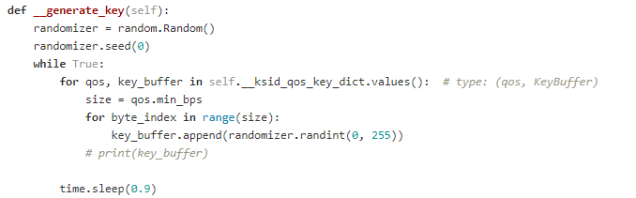
Random number generator
Periodically add a key to the buffer (every 0.9 seconds)
Same seed -> same key

Slide 11
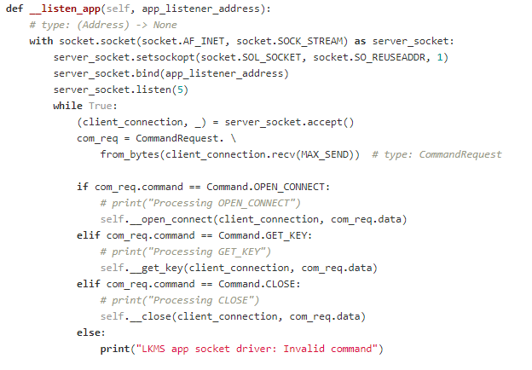
LKMS
Spawns thread with socket listener
Answers API calls
Also spawns thread with key generator
The keys are stored in the LKMS class (not accessible anywhere else)

Slide 12
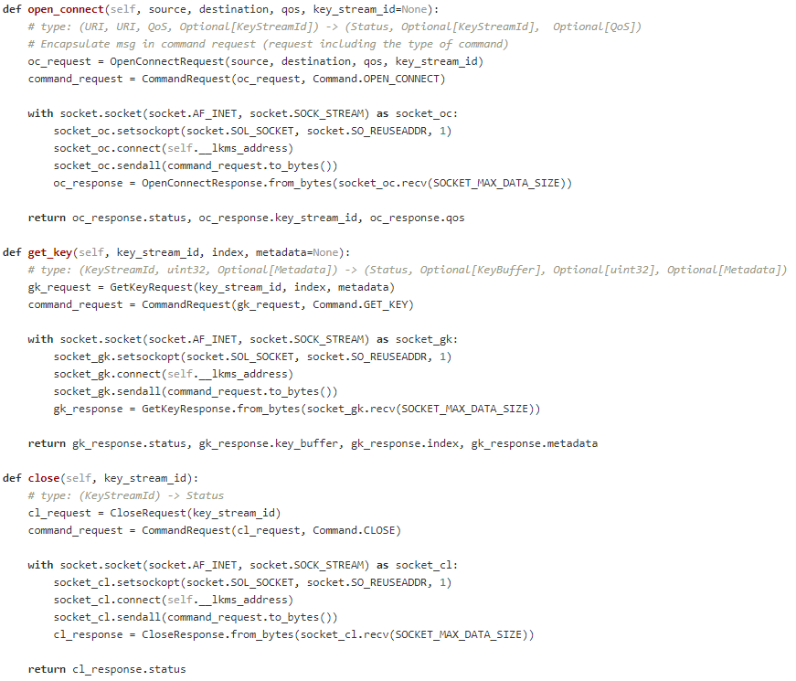
Application driver
Translates the API calls with python variables to a TCP packet

Slide 13
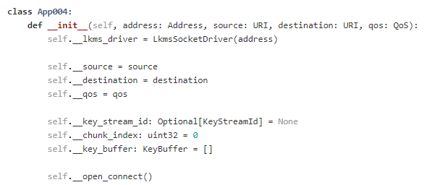
Application class
Abstracts the programmer from the API calls
Allows the programmer to directly encrypt/decrypt his messages or get the key bytes

Slide 14
Examples

Slide 15
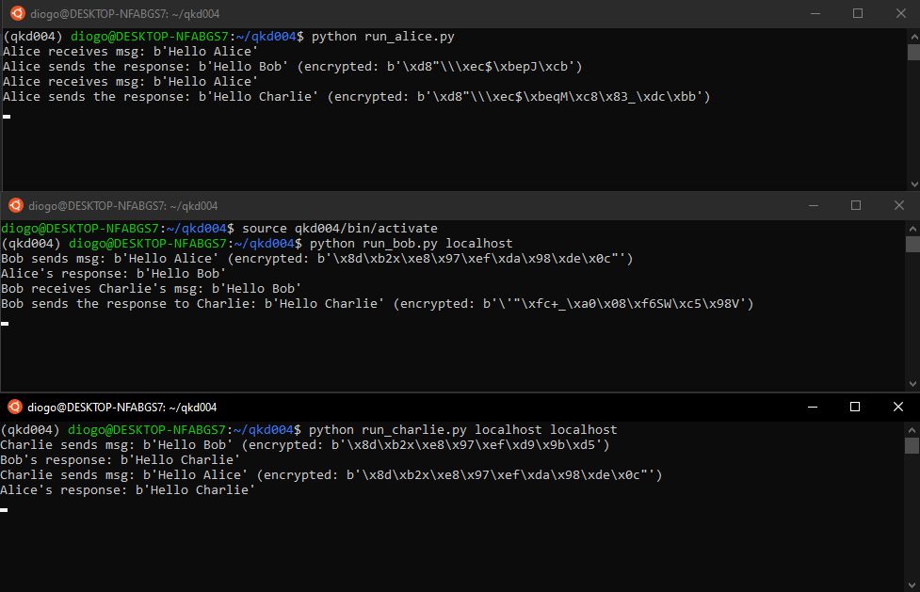

Slide 16
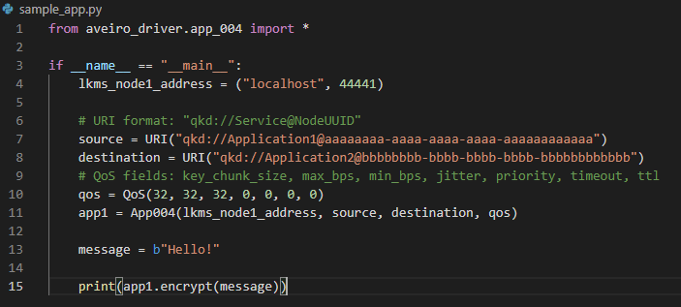
Encrypting a message

Slide 17
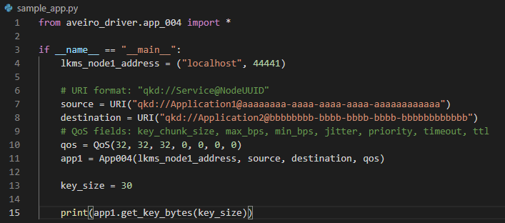
Getting keys

